Slide 1




Université Abdelmalek Essaadi Ecole Nationale Des Sciences Appliquées de Tanger
Northeastern University -Boston-Fall 2017
Soutenance de stage d’été:
Final Project
Radio app
Team: Flying Turkey
Supervised by: Mr.Amuthan Arulraj

Slide 2
Introduction :Application Architecture
The Use case && UML Diagram
Outline
Implementation: Client-Side
Implementation: Server-Side

Slide 3
Firebase
Inventory
Architecture
User Info
Orders
Submit data to Firebase
Fetch data from Firebase
Local
Storage order data temporarily
SQLite
Restaurant Application
Get order data

Slide 4
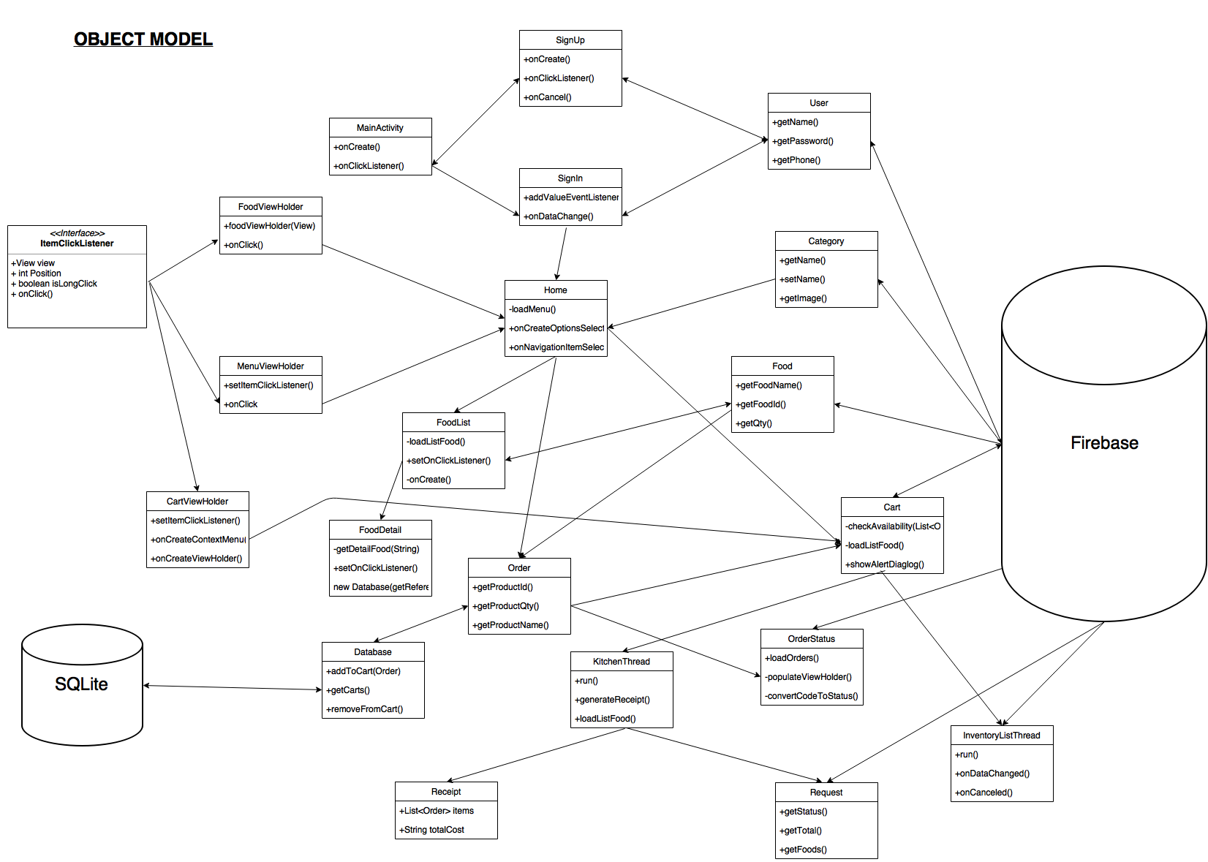
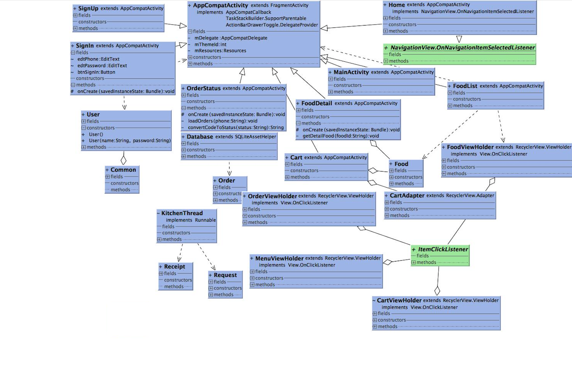
UML Diagram

Slide 5
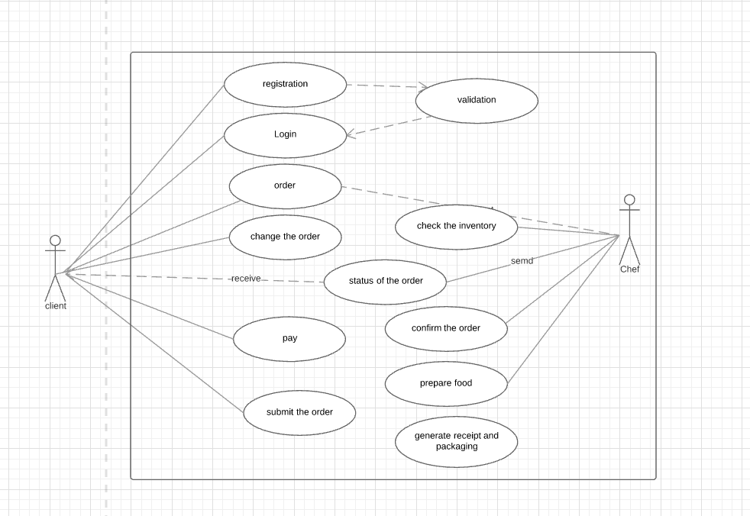
Use case

Slide 6
PART 1
The Login and registration
Notes:
In this part i will talk about the main screen,the sing in activity and the sign up

Slide 7
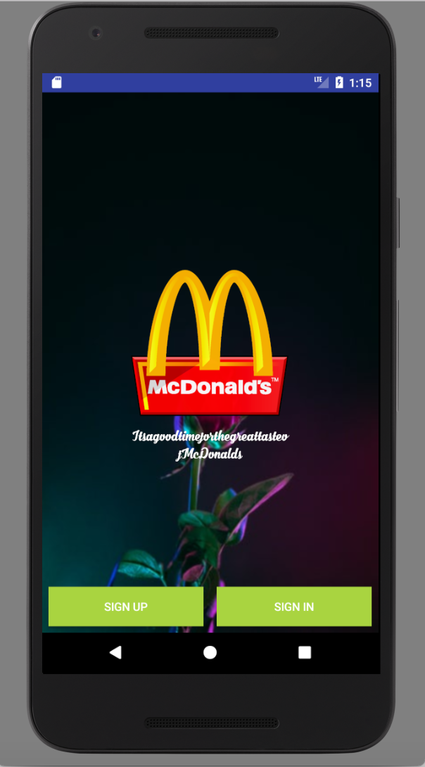
The MainActivity
Add Firebase to the Android Project:
enter your app's package name
download a google-services.json file
add rules to root-level build.gradle file, to include the google-services plugin
Design the mainActivity screen:
Add an image to the drawable file
Add two button Sign-In and Sign-up
Link the Xml file to the java file it with two step process
-Create a variable that will hold the layout element and
retrieve that layout and store it to the variable that we created
-Retrieve the elements from the xml file by find it by id
-setOnClickListener tow the button Instantiate the intent object Then start the activity by startActivity()
Notes:
Add Firebase to the Android Project
Create a Firebase project in the Firebase console, if you don't already have one. If you already have an existing Google project associated with your mobile app, click Import Google Project. Otherwise, click Add project.
Click Add Firebase to your Android app and follow the setup steps. If you're importing an existing Google project, this may happen automatically and you can just download the config file.
When prompted, enter your app's package name. It's important to enter the package name your app is using; this can only be set when you add an app to your Firebase project.
At the end, you'll download a google-services.json file. You can download this file again at any time.
If you haven't done so already, copy this into your project's module folder, typically app
dd the SDK
If you would like to integrate the Firebase libraries into one of your own projects, you need to perform a few basic tasks to prepare your Android Studio project. You may have already done this as part of adding Firebase to your app.
First, dd rules to your root-level build.gradle file, to include the google-services plugina and the Google's Maven repository:
Link the Xml file to java file it is two step process
Create a variable that will hold the layout element and then retrieve that layout and store it to that variable that we created
Retrieve the elements from the xml file we find it by id
The main activity has an image view ,textview and 2buttons sign up and sign in
Setting listeners
public void onClick(View view) {
Intent signin = new Intent(MainActivity.this, SignIn.class);
startActivity(signin);
btnSignUp.setOnClickListener(new View.OnClickListener() {
@Override
public void onClick(View v) {
Intent signup = new Intent(MainActivity.this, SignUp.class);
startActivity(signup);

Slide 8
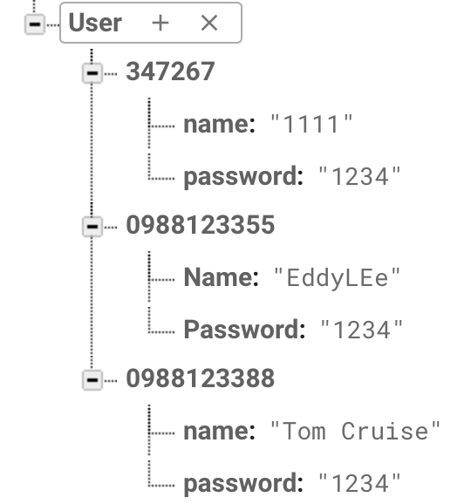
Fire Base data for User
Key: phoneId
Data: Name, password
Key
Data
Notes:
Now to make the buttons fully armed and operational. You are going to have a press of each button trigger a pop-up message called a toast. A toast is a short message that informs the user of something but does not require any input or action. You are going to make toasts that announce whether the user answered correctly or incorrectly
Making Toasts
Now to make the buttons fully armed and operational. You are going to have a press of each button trigger a pop-up message called a toast. A toast is a short message that informs the user of something but does not require any input or action. You are going to make toasts that announce whether the user answered correctly or incorrectly (Figure 1.14).

Slide 9
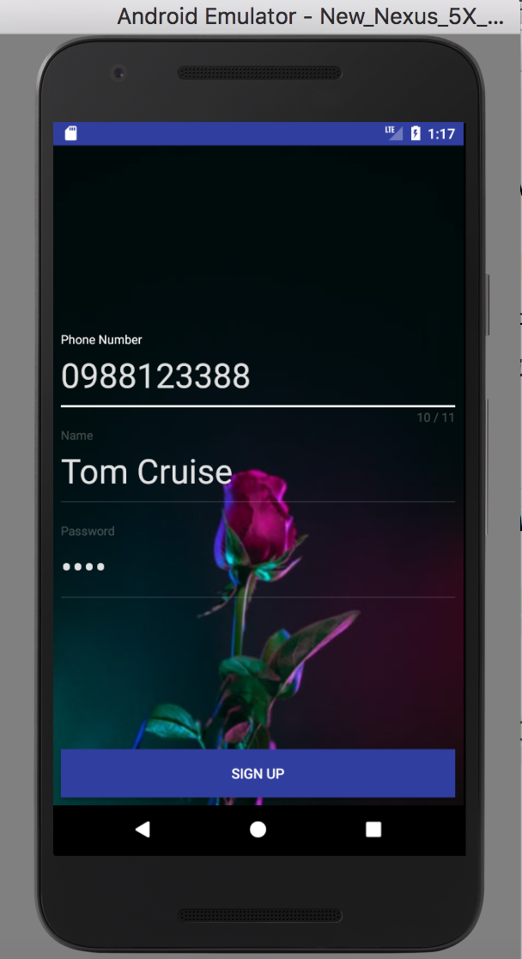
Sign up Activity
Design the Activity In sign-up.xml
-<MaterialEditText tag where we can edit the inputs
-Sign Up Button
To read or write data from the database, you need an instance of DatabaseReference
FirebaseDatabase database = FirebaseDatabase.getInstance();
final DatabaseReference table_user = database.getReference("User");
onDataChange(DataSnapshot dataSnapshot)
-DataSnapshot instance contains data from a Firebase location and compare it to the input if already exist will show a toast text that the number already exist
Toast.makeText(SignUp.this, "Phone number already registered !",
-else if not It Will get the text and set the value to the User database and sign up
Notes:
table_user.addValueEventListener(new ValueEventListener()
An DataSnapshot instance contains data from a Firebase location. Any time you read Firebase data, you receive the data as a DataSnapshot.
DataSnapshots are passed to the methods in listeners that you attach with Query.addValueEventListener(ValueEventListener),Query.addChildEventListener(ChildEventListener), or Query.addListenerForSingleValueEvent(ValueEventListener).
They are efficiently-generated immutable copies of the data at a Firebase location. They can't be modified and will never change. To modify data at a location, use a Firebase reference (e.g. with Firebase.setValue(Object)).
Now to make the buttons fully armed and operational. You are going to have a press of each button trigger a pop-up message called a toast. A toast is a short message that informs the user of something but does not require any input or action. You are going to make toasts that announce whether the user answered correctly or incorrectly

Slide 10
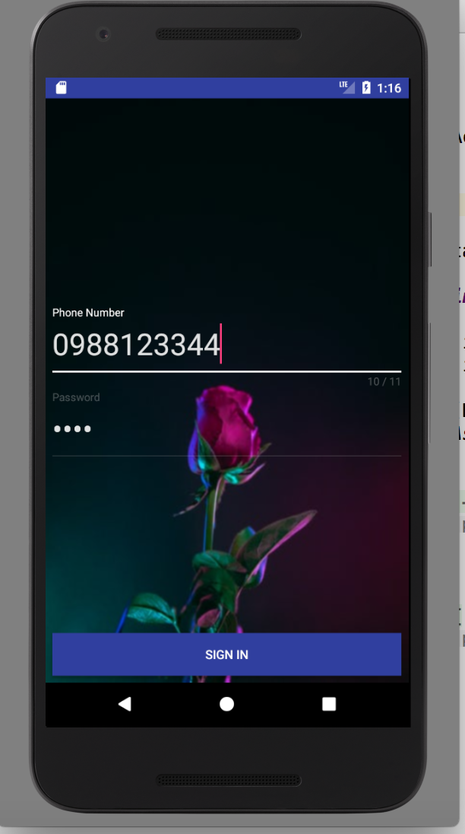
Sign in Activity
<MaterialEditText with phone Id and password Id
Button sign Up - set an setOnClickListener
Get the value (phone number) check if it exist() then getPassword()
Check if it is equal the the password on the database if yes
startActivity(homeIntent)
If the phone number doesn't exist
Toast.makeText(SignIn.this, "User not exist in Database !",) If the password in not equal to the password in the database
Toast.makeText(SignIn.this, "Wrong Password !",)
Intent homeIntent = new Intent(SignIn.this, Home.class);
Common.currentUser = user;
Notes:
Now to make the buttons fully armed and operational. You are going to have a press of each button trigger a pop-up message called a toast. A toast is a short message that informs the user of something but does not require any input or action. You are going to make toasts that announce whether the user answered correctly or incorrectly
Making Toasts
Now to make the buttons fully armed and operational. You are going to have a press of each button trigger a pop-up message called a toast. A toast is a short message that informs the user of something but does not require any input or action. You are going to make toasts that announce whether the user answered correctly or incorrectly (Figure 1.14).

Slide 11
PART 2
Food Menu and Food Detail

Slide 12
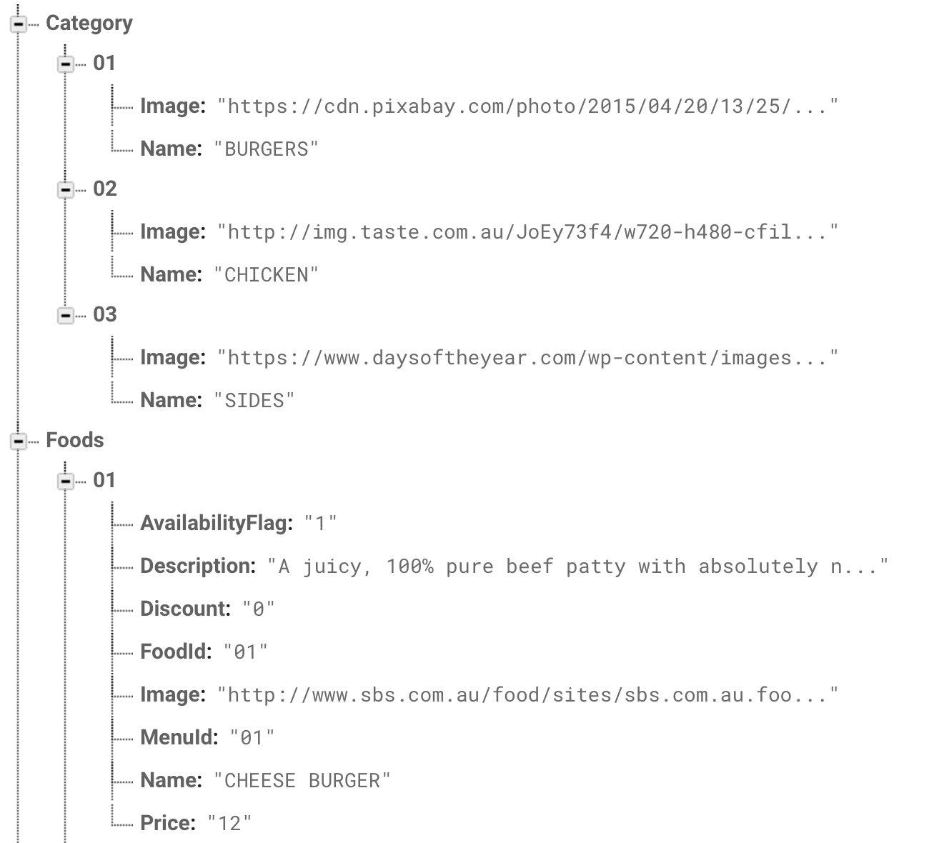
Firebase Data
Data Screenshot for Menu Part
Notes:
Load more data into firebase, create the key category and load data such as .. create key foods load data such as.. And the menuId is the corresponding catagoryid

Slide 13
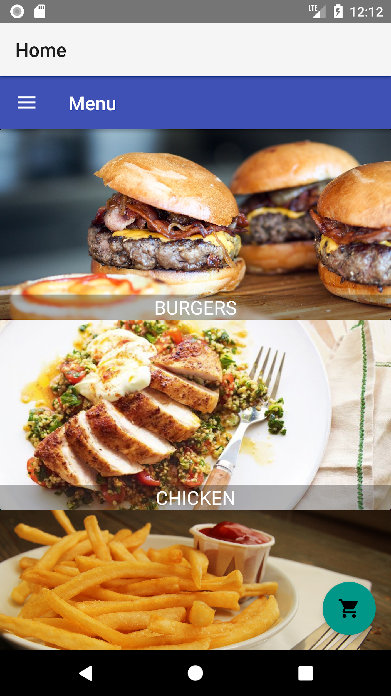
Food Category
Key: CategoryId
Data: Food Name, Food Image
JSON file
Firebase
Declare Category Class Model with variables same as database
Create MenuViewHolder with TextView and ImageView, setItemClickListener
Design Home Screen create Home Activity
FirebaseDatabase.getInstance()
database.getReference(“Category”)
loadMenu()
LoadMenu
FirebaseRecyclerAdapter<Category,MenuViewHolder>
Use setItemClickListerner, override onClick() to get CategoryId and start new foodList Activity
foodList.putExtra use CaterogyId as key

Slide 14
Food Category
private void loadMenu() {
//FirebaseRecyclerAdapter, connect Catergory class and MenuViewHolder
adapter = new FirebaseRecyclerAdapter<Category,MenuViewHolder>(Category.class,R.layout.menu_item,MenuViewHolder.class,category) { //Populate View for Screen
@Override
protected void populateViewHolder(MenuViewHolder viewHolder, Category model, int position) {
//Load Category Name for Each Category
viewHolder.txtMenuName.setText(model.getName());
//Load Picture for Each Category
Picasso.with(getBaseContext()).load(model.getImage()).into(viewHolder.imageView);
final Category clickItem = model;
//use setItemClickListener to keep track which category is clicked
viewHolder.setItemClickListener(new ItemClickListener() {
@Override
public void onClick(View view, int position, boolean isLongClick) {
//Create new intent with foodList class
Intent foodList = new Intent(Home.this, FoodList.class);
//Pass the CategoryId to the foodList activity
foodList.putExtra("CategoryId", adapter.getRef(position).getKey());
startActivity(foodList);
}
});
}
};
recycler_menu.setAdapter(adapter);
}

Slide 15
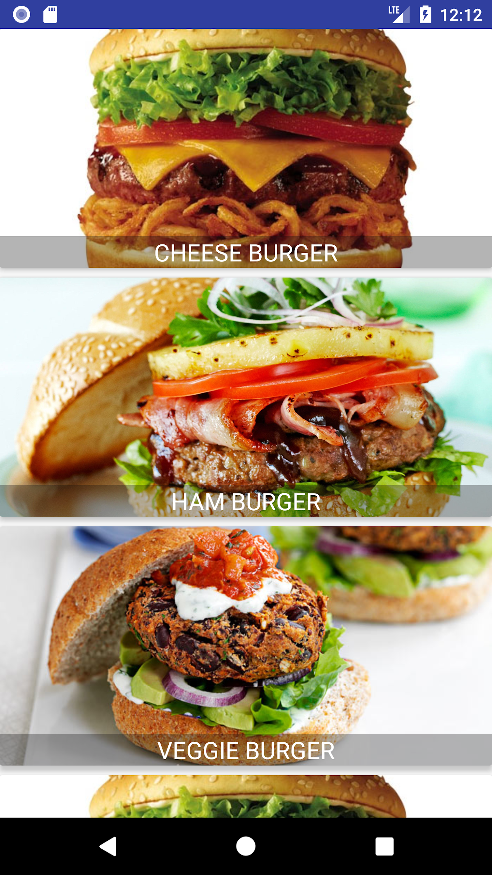
Food List
Key: FoodId
Data: Food Name, Food Image,Food Price, Food Description, FoodId, AvailabilityFlag
JSON file
Firebase
Declare Food Class Model with variables same as database
Create FoodViewHolder with TextView and ImageView, setItemClickListener
Design FoodList Screen create FoodList Activity
FirebaseDatabase.getInstance()
database.getReference(“Foods”)
loadListFood(categoryId)
LoadListFood
FirebaseRecyclerAdapter<Food,FoodViewHolder>
foodList.orderByChild("MenuId").equalTo(categoryId)
Use setitemClickListerner to get FoodId and start new foodDetail Activity
foodDetail.putExtra use FoodId as key

Slide 16
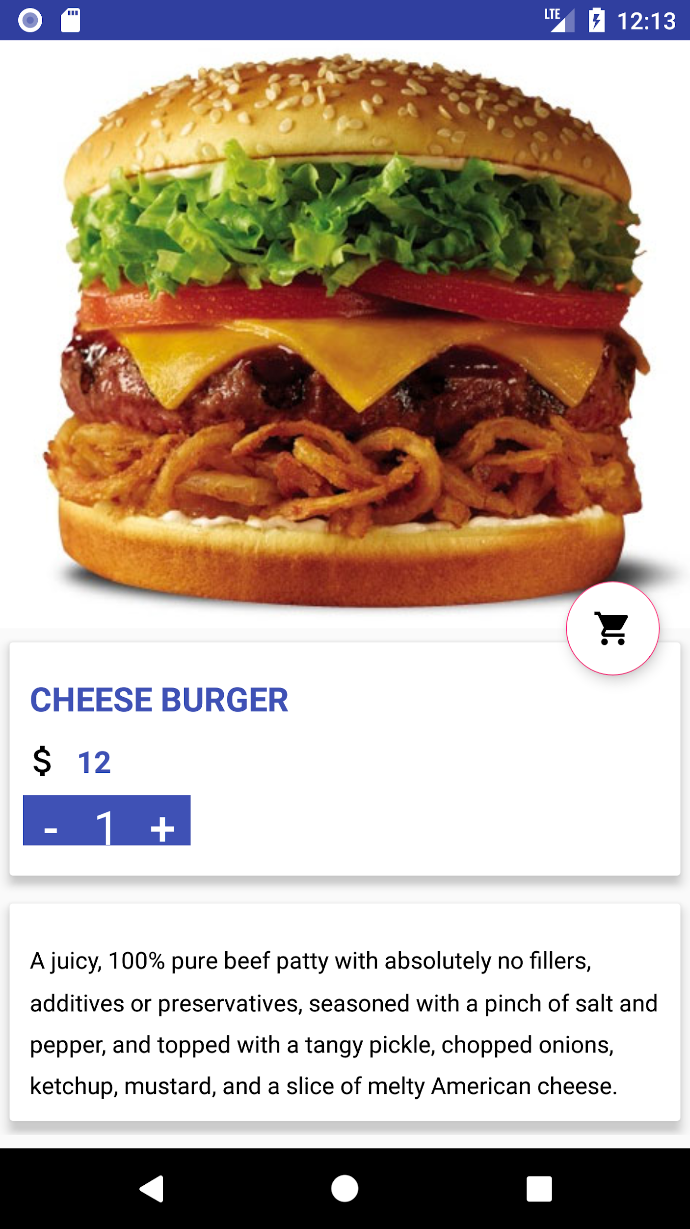
Food Detail
Design FoodDetail User Interface
Create FoodDetail Activity
Use foodId passed from foodList activity to get the detail of certain food
getDetailFood(String foodId), load image, price, name,
Description for particular food
Create Cart button and Number button for selection quantity of foods and place in Cart
Click on Add to cart button adds the food item to SQLite Database

Slide 17
PART3
Cart And Orders

Slide 18
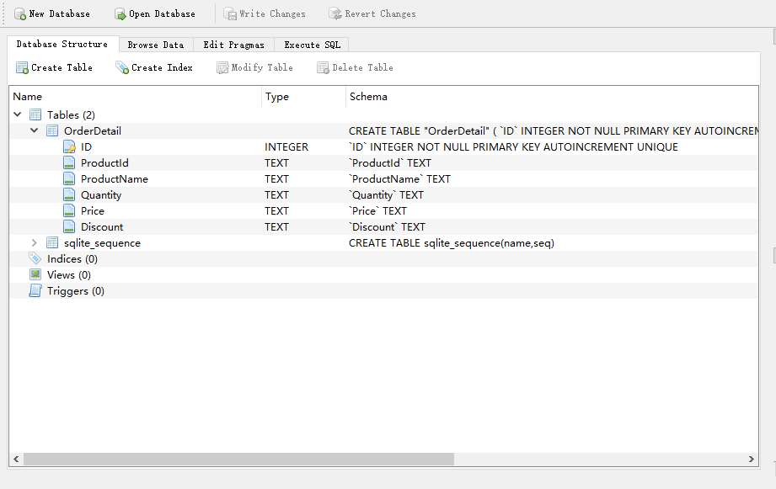
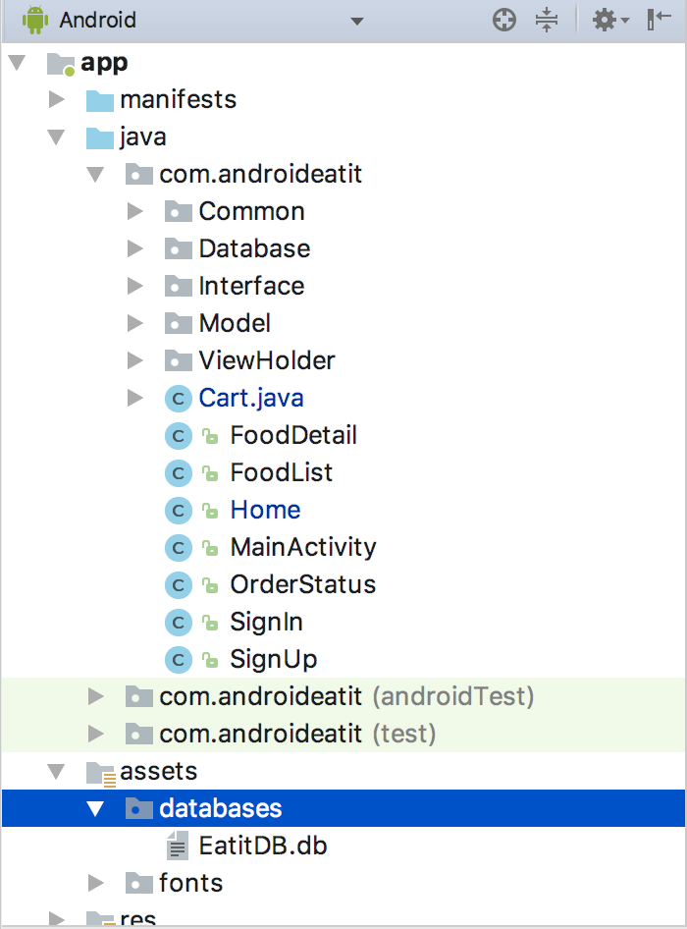
SQLite Database
Added library SQLiteAssetHelper to build.gradle for working with SQLite Database
Using DB Browser for SQLite, created a new database EatItDB.db and created a new Table within called OrderDetail
Using EatitDB to temporarily store food items in the cart
Created new class Order in model to get and set attributes to and from the database
If user has items in cart and closes application, food items will stay in cart.
Notes:
●Why are we using SQLit database:
●Very expensive (time) to store temporary data on Firebase database
●We have made use of SQLite database to temporarily store all the food items that the user has added to cart along with its many properties like productID, productName, qty, Price and discount
●The items will remain in the cart till the user confirms order even if he closes and reopens the application
●
●How are we using SQLit Database
●To do this, we have compiled the library SQLiteAssetHelper to build.gradle
●Using the application DB Browser for SQLite, we created a new database EatItDB.db and created a new Table in the database called OrderDetail
○In table order detail we added attributes values: id(not null UNIQUE), productId, ProductName, Quantity, Price, Discount
○Added this database to /assets/database/EatItDb.db folder
●Create a new java class database.java where we write functions for DB like addToCart() , deleteFromCart(), clearCart()

Slide 19
Database Queries
To access database methods:
New Database(getBaseContext()).addToCart(new Order(
foodId,
currentFood.getName(),
numberButton.getNumber(),
currentFood.getPrice(),
currentFood.getDiscount()));
Click on button fires addToCart() method which inserts the product with specified quantity into the table OrderDetail:
Public void addToCart(Order order){
SQLiteDatabase db = getReadableDatabase();
String query = String.format(“INSERT INTO ORDERDETAIL(ProductId, ProductName, Quantity, Price, Discount)” + “Values(‘%s’,‘%s’,‘%s’,‘%s’,‘%s’,);”,
order.getProductId(),order.getProductName(),order.getQuantity(),order.getPrice(),order.getDiscount());
db.execSQL(query)
Method getCarts() returns all the products that are already in the cart:
SQLiteDatabase db = getReadableDatabase();
SQLiteQueryBuilder qb = new SQLiteQueryBuilder();
String[] sqlSelect = {“ProductName”,”ProductId”,”Quantity”,”Price”,”Discount”};
String sqlTable = “OrderDetail”;
qb.setTables(sqlTable);
Cursor c = qb.query(db, sqlSelect);
Final List<Order> result = new ArrayList<>();
if(c.moveToFirst()){
Do{
result.add((new Order(c.getString(c.getColumnIndex(“ProductId”)), c.getString(c.getColumnIndex(ProductName”)),c.getString(c.getColumnIndex(“Quantity”)),
c.getString(c.getColumnIndex(“Price”)),c.getString(c.getColumnIndex(“Discount))));
}while(c.moveToNext());
} return result;
Notes:
To access any database method, we create a constructor of java class Database, pass the base context, and call the method we want to access
The method getCarts() gets all the previously added orders which are stored in the sqlite database and returns the list of items in the cart to be displayed on the UI
The method addToCart(Order order) fires a query on the sqlite database and we add a new order into the OrderDetail table
The method cleanCart() is called once the order is processed to remove the list of items from the cart
We then write function for button add to cart in fooddetail.java
On click of this button we call the method addToCart that is defined in the database Java class and pass the values of the currentFood that is clicked on.
We then create a toast which displays add to cart

Slide 20
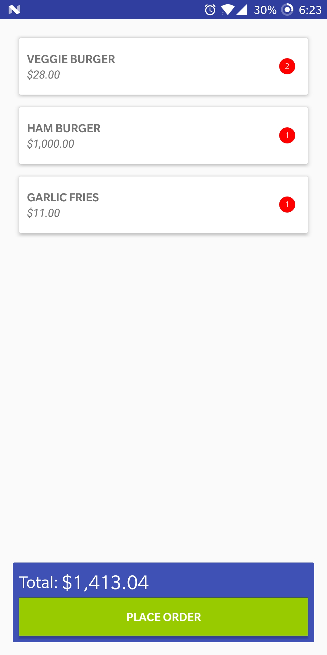
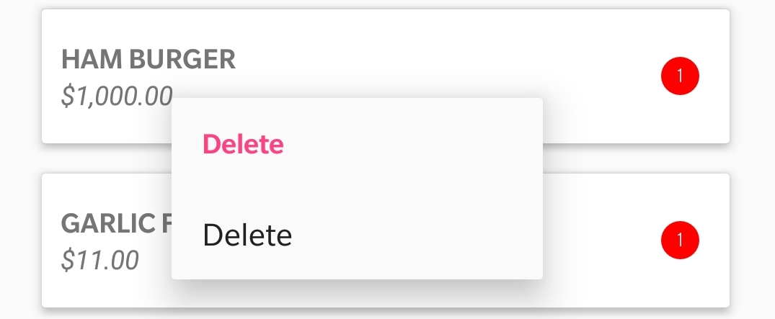
Cart View Holder
All the individual items with Quantity, Price, and Name along with the Total Price and Place Order button are displayed on this page.
Long pressing on an individual item gives user option to delete item from cart.
Clicking on Delete button passes the unique orderId to database.java where we fire query to remove item from database. This updates the view and displays new Total Amount.
Click on Place Order button alerts the user to enter his email address and passes the request to the Kitchen.
If the Kitchen accepts order, cleanCart() method is called which deletes the table from SQLite Database and empties the cart list.
Public void cleanCart(){
SQLiteDatabase db = getReadableDatabase();
String query = String.format(“DELETE FROM OrderDetail”);
db.execSQL(query);
}
Public void removeFromCart(String order){
SQLiteDatabase db = getReadableDatabase();
String query = String.format(“DELETE FROM OrderDetail WHERE ProductId = ‘“+order+”’”);
Fires
Notes:
We have created a cart class where we have the total price of the order and a place order button. We have made use of recycler view to populate items on this page..
New layout to show cart
THE XML layout consists of a recycler view. The major advantage of recycler view is that it populate the view at the run time, hence less memory and you can create the dynamic, more efficient and robust view hierarchy using the Recycler View
The items have information like item name, quantity and price. The cart view has further information like total price of order.
Suppose we don’t want an item and change our mind, we can delete an item from the cart by holding on an item. This will display a option to delete the item. This is done by implementing View.OnCreateContextMenuListener on on the cartviewholder class
Clicking on delete button passes the unique orderid to database.java where we fire query to remove item from database.

Slide 21
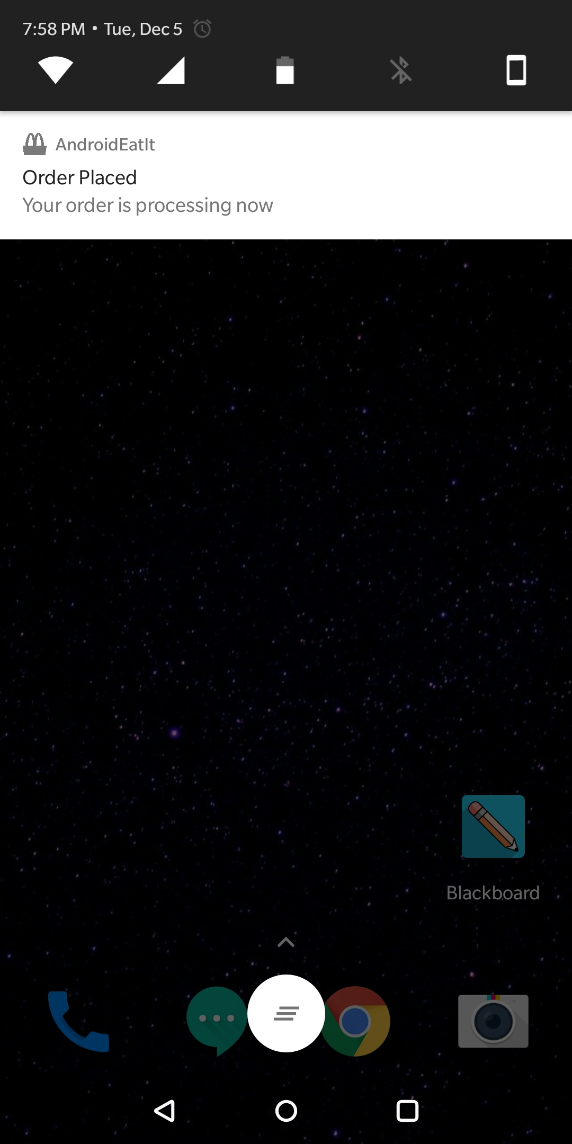
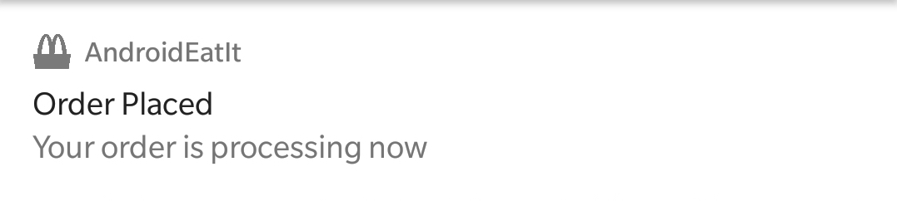
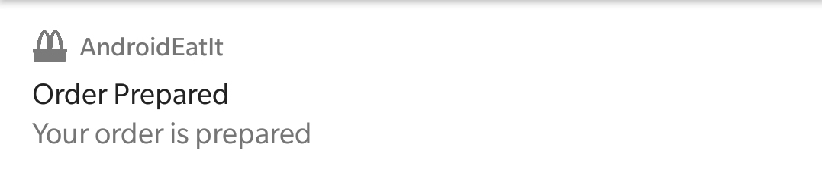
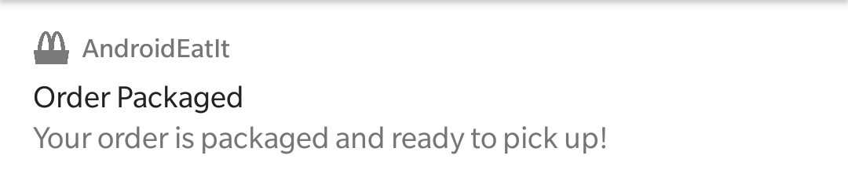
Notification Bar
Depending on status flag received from server, we display notification on user device along with small app icon on status bar.
If Status = 1:
If Status = 2:
If Status = 3:

Slide 22
Show Notification
Builder class for notification. Provides Convenient way to set various fields of a notification
//Code to show notification
Intent intent = new Intent();
PendingIntent pendingIntent = PendingIntent.getActivity(Cart.this,0,intent,0);
Notification.Builder notificationBuilder = new Notification.Builder(Cart.this)
.setTicker("Order Placed")
.setContentTitle("Order Placed")
.setContentText("Your order is processing now")
.setSmallIcon(R.drawable.logo)
Notification notification = notificationBuilder.build();
notification.flags = Notification.FLAG_AUTO_CANCEL;
NotificationManager nm = (NotificationManager) getSystemService(NOTIFICATION_SERVICE);
assert nm != null;
nm.notify(0,notification);
}
});
This Class represents how persistent notification is to be presented to user
Class to notify the user of events that happen. How we show user that something has happened in background

Slide 23
PART 4
Server Side
Part I

Slide 24
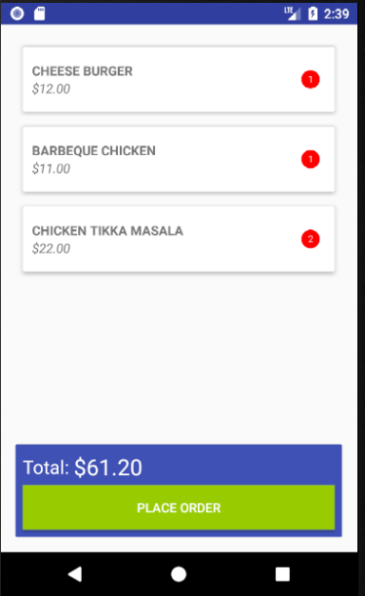
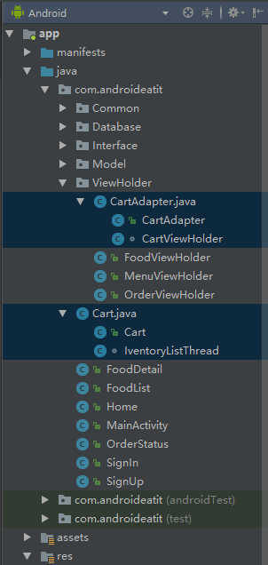
Cart Design
Cart activity
CartAdapter and CartViewHolder to load the food in cart
Place Order CardView
Total Price
Place Order Button
loadListFood method
Get foods data from SQLite using getCarts() provided by SQLite Database class
Set the foods data to CartAdapter and display them in RecylerView

Slide 25
InventoryList
//The executor can makes inventorylistthread running in interval, which is 1 hour
ScheduledExecutorService executor = Executors.newSingleThreadScheduledExecutor();
//thread running in 1 hour interval
executor.scheduleAtFixedRate(inventorylistthread, 0, 60, TimeUnit.MINUTES);
//When the "Place Order" button clicked
btnPlace.setOnClickListener(new View.OnClickListener() {
@Override
public void onClick(View v) {
//update invetoryList immediately first
executor.scheduleAtFixedRate(inventorylistthread, 0, 60, TimeUnit.MINUTES);
//this thread updates the inventoryList from firebase
class IventoryListThread implements Runnable
{
DatabaseReference foods = FirebaseDatabase.getInstance().getReference("Foods");
public void run()
{
foods.addValueEventListener(new ValueEventListener() {
@Override
public void onDataChange(DataSnapshot dataSnapshot) {
inventoryList.clear();
for(DataSnapshot singleSnapshot : dataSnapshot.getChildren()){
inventory = singleSnapshot.getValue(Food.class);
inventoryList.add(inventory);
}
System.out.println(inventoryList.size());
}
@Override
public void onCancelled(DatabaseError databaseError) {
}
});
}
}

Slide 26
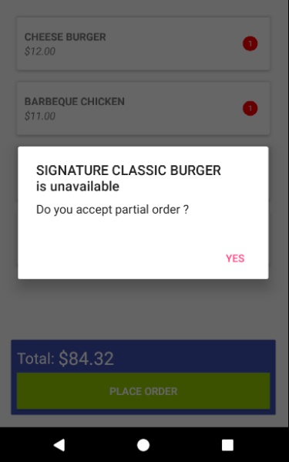
Food Availability Check
//Find out whether the foods in order contains unavailable food
private boolean checkavailability(List<Order> cart){
boolean partial = false;
if(cart.size()==0){
//Cart is empty, do nothing
partial = true;
}
for(Order order : cart){
for(Food food: inventoryList){
if(food.getFoodId().equals(order.getProductId())){
if(food.getAvailabilityFlag().equals("0")){
//if the availabilityFlag of this food is "0"
partial = true;
unavailablefoodprice += Integer.parseInt(food.getPrice());
unavailablefoodprice = (float) (unavailablefoodprice*1.36);
unavailablefoodnames += food.getName();
}
}
}
}
return partial;
}

Slide 27
showAlertDialog
if(partial) {
request.setPartial(true);
//add the request to top of the requestList if it's partial request
requestList.add(0,request);
//default partial is false, set it back to false to check next request
partial = false;
//cut the price of unavailable food
//keep track of totalprice using global variable
//txtTotalPrice is in currency format unable to parse
Locale locale = new Locale("en","US");
NumberFormat fmt = NumberFormat.getCurrencyInstance(locale);
request.setTotal(fmt.format(totalPrice - unavailablefoodprice));
unavailablefoodprice = 0;
}else {
requestList.add(request);
}
//Submit to Firebase
requestId=String.valueOf(System.currentTimeMillis());
requests.child(requestId).setValue(request);
//run the kitchenthread
kitchenthread.start();
private void showAlertDialog() {
AlertDialog.Builder alertDialog = new AlertDialog.Builder(Cart.this);
alertDialog.setTitle("One more step!");
alertDialog.setMessage("Enter your address");
System.out.println("email address ");
final EditText edtAddress = new EditText(Cart.this);
LinearLayout.LayoutParams lp = new LinearLayout.LayoutParams(
LinearLayout.LayoutParams.MATCH_PARENT,
LinearLayout.LayoutParams.MATCH_PARENT
);
edtAddress.setLayoutParams(lp);
alertDialog.setView(edtAddress);
alertDialog.setIcon(R.drawable.ic_shopping_cart_black_24dp);
alertDialog.setPositiveButton("YES", new DialogInterface.OnClickListener() {
@Override
public void onClick(DialogInterface dialog, int which) {
Request request = new Request(
Common.currentUser.getPhone(),
Common.currentUser.getName(),
edtAddress.getText().toString(),
txtTotalPrice.getText().toString(),
cart
);

Slide 28
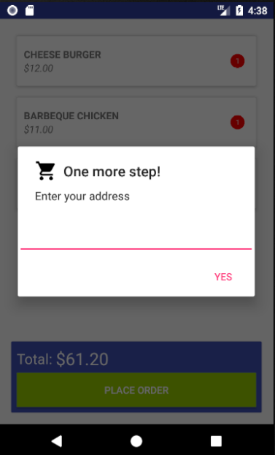
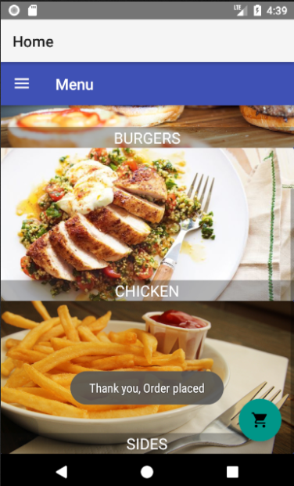
Order Placed Successfully

Slide 29
Kitchen Thread
//this thread cooks requests
class KitchenThread implements Runnable{
@Override
public void run() {
while (true) {
while (requestList.size() > 0) {
DatabaseReference requests = FirebaseDatabase.getInstance().getReference("Requests");
requests.child(requestId).child("status").setValue("1");
System.out.println("The chef is working on requests!!!!!!!!!!!!!!!!!!!!!!!!!!!!!!!!!!!!!!!!!!!!!!!!!!!!!!!!!!");
try {
//cooking time: 180 sec
Thread.sleep(10000);
} catch (InterruptedException e) {
e.printStackTrace();
}
System.out.println("Order Prepared!");
requests.child(requestId).child("status").setValue("2");
try {
//packaging time: 180 sec
Thread.sleep(10000);
} catch (InterruptedException e) {
e.printStackTrace();
}
System.out.println("Order Packaged!");
requests.child(requestId).child("status").setValue("3");
//The first request finished, generate receipt, then remove the finished request, working on next request in list
Looper.prepare();
Toast.makeText(Cart.this,GenerateReceipt(requestList.get(0)),Toast.LENGTH_SHORT).show();
requestList.remove(0);
Looper.loop();
}
System.out.println("there are no requests yet, what a terrible day!!!!!!!!!!!!!!!!!!!!!!!!!!!!!!!!!!!!!!!!!!!!!!!!!!!!!!!!!!!");
}
}

Slide 30
PART 4
Server Side
Part II

Slide 31
Kitchen Thread
//this thread cooks requests
class KitchenThread implements Runnable{
@Override
public void run() {
while (true) {
while (requestList.size() > 0) {
DatabaseReference requests = FirebaseDatabase.getInstance().getReference("Requests");
requests.child(requestId.get(0).child("status").setValue("1");
System.out.println("The chef is working on requests!!!!!!!!!!!!!!!!!!!!!!!!!!!!!!!!!!!!!!!!!!!!!!!!!!!!!!!!!!");
try {
//cooking time: 180 secs
Thread.sleep(10000);
} catch (InterruptedException e) {
e.printStackTrace();
}
System.out.println("Order Prepared!");
requests.child(requestId.get(0).child("status").setValue("2");
try {
//packaging time: 20 secs
Thread.sleep(10000);
} catch (InterruptedException e) {
e.printStackTrace();
}
System.out.println("Order Packaged!");
requests.child(requestId.get(0).child("status").setValue("3");
//The first request finished, generate receipt, then remove the finished request, working on next request in list
Looper.prepare();
Toast.makeText(Cart.this,GenerateReceipt(requestList.get(0)),Toast.LENGTH_SHORT).show();
requestList.remove(0);
requestId.remove(0);
Looper.loop();
}
System.out.println("there are no requests yet, what a terrible day!!!!!!!!!!!!!!!!!!!!!!!!!!!!!!!!!!!!!!!!!!!!!!!!!!!!!!!!!!!");
}
}

Slide 32
Kitchen Thread
requestList, that is Order List
Change to Status “1”
Preparing
Check requestList
Have order!
Prepare-- kitchen thread sleep 180 secs
Change to Status “2”
Packaging
Remove the first order in the requestList
Package-- kitchen thread sleep 20 secs
Change to Status “3”
Food Ready
Generate Receipt

Slide 33
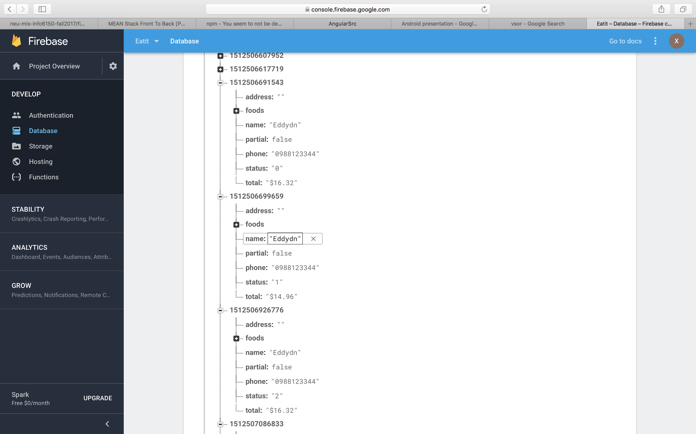
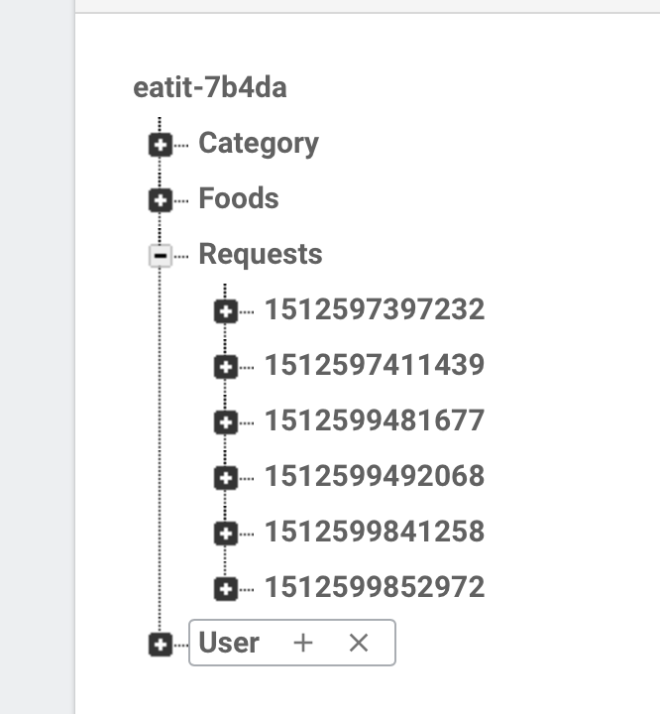
Kitchen Thread
public class Request
{
private String phone;
private String name;
private String address;
private String total;
private String status;
private List<Order> foods;
private boolean partial = false;
}
DatabaseReference requests
=FirebaseDatabase.getInstance().getReference(“Requests”)
Static variable requestId[], System.currentTimeMillis()
setValue()

Slide 34
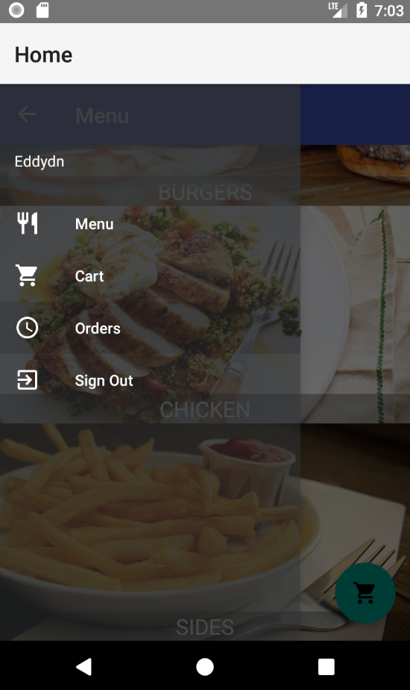
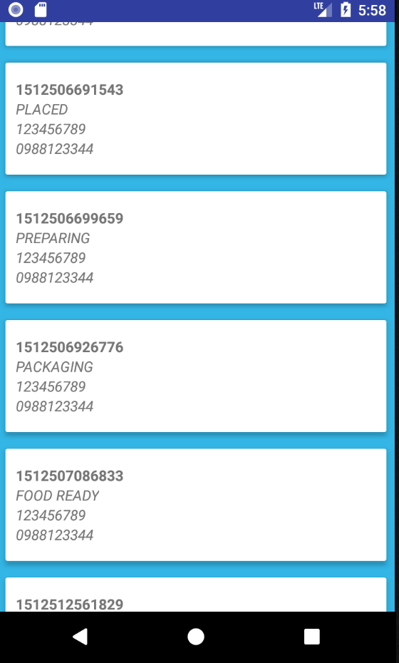
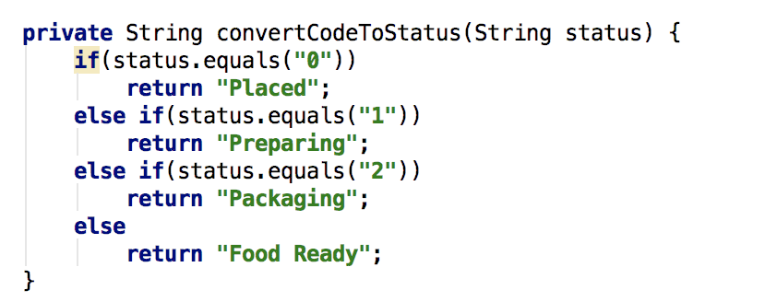
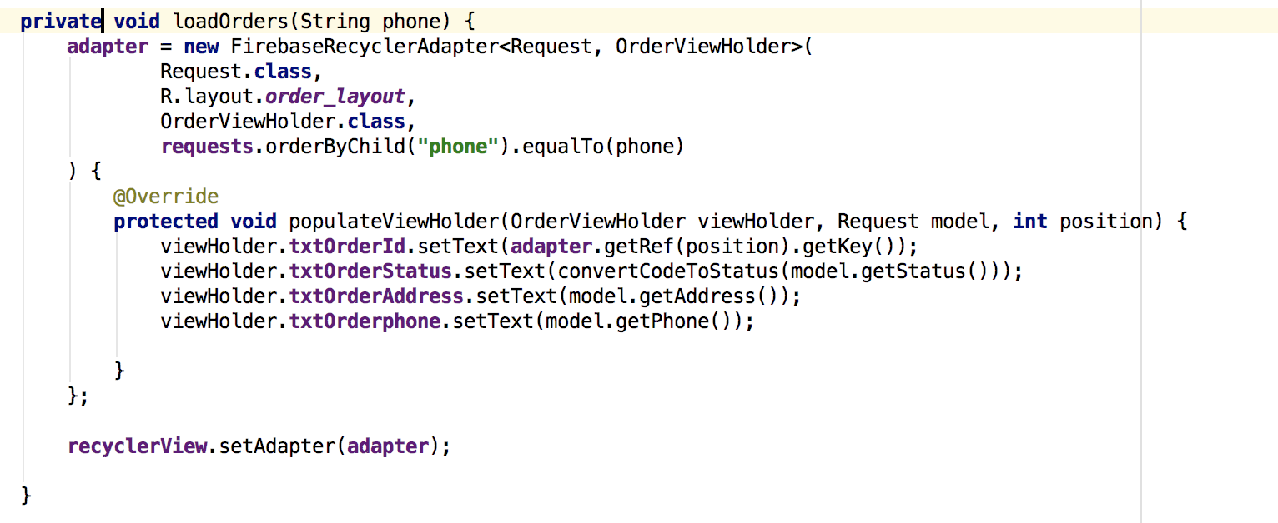
Order Status
0: Placed
1: Preparing
2: Packing
3: Food Ready

Slide 35
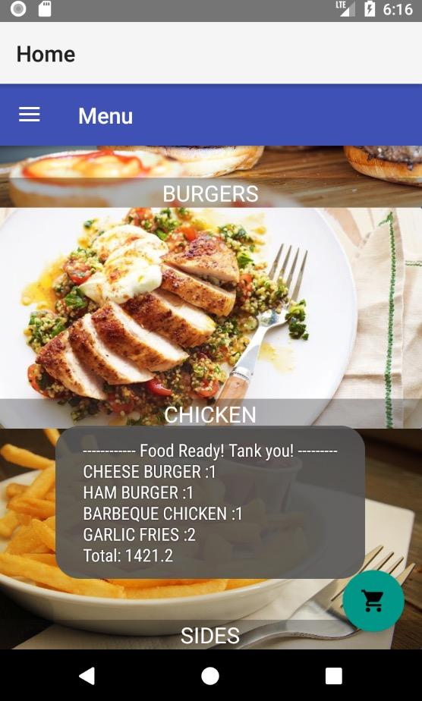
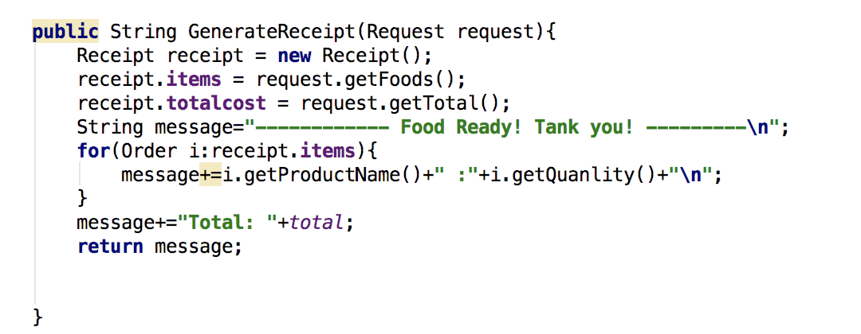
Generate receipt
public class Receipt
{
public List<Order> items;
public String totalcost;
}

Slide 36

Thank you for your attention!

Slide 37
Université Abdelmalek Essaadi Ecole Nationale Des Sciences Appliquées de Tanger
Final Project
Soutenance de stage d’été:
Food Application on Android
Fall 2017

